Slide 1
Modeling Neural Connection Properties with Random Graph Generation
Isabel Ehrhardt

Slide 2
Big Question
Can a random graph generation algorithm produce a ‘brain-like’ graph?
Breakdown:
What is a ‘brain-like’ graph ?
Can we measure ‘brain-like’ ?
Can we create ‘brain-like’ ?

Slide 3
Background: Connectome as a Graph
Brain can be viewed as a graph
neuron = node
synapse = directed edge
~10^11 neurons
~10^15 synapses
Question:
What graph properties does the brain need to function // what is ‘brain-like’?
Notes:
One way to answer: look for properties different from random graphs studied in class

Slide 4
Background: Non-[Uniform] Connectivity
One graph property is from:
Highly Nonrandom Features of Synaptic Connectivity in Local Cortical Circuits (2005) Sen Song,Per Jesper Sjöström,Markus Reigl,Sacha Nelson,Dmitri B Chklovskii
Studies connections in layer 5 pyramidal neurons of rat visual cortex (~90 ?)
Look at 3-neuron connection patterns and connection strength
Findings:
3-neuron connection patterns are not random
Highly connected neurons have stronger connections
“a skeleton of stronger connections is immersed in a sea of weaker ones”
Notes:
Does this generalize?

Slide 5
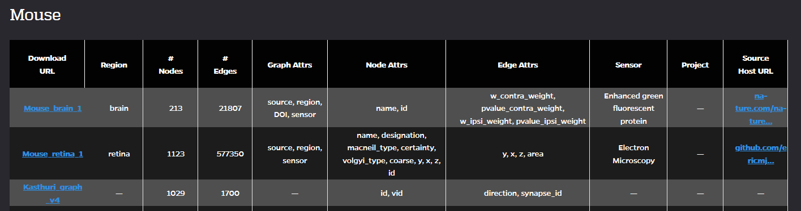
Step 0: Get Data
All connectome data from: https://neurodata.io/project/connectomes/
Offers data from connectome studies as graphs
Graphs as .graphml files
Notes:
Ok so back to question, do the non-random properties generalize?

Slide 6
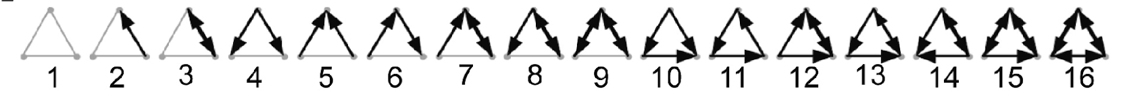
Step 1: Count types of 3 way connections
Label 16 patterns
Look at all collections of 3 neurons in a graph file, classify type
Calculate % of each type
Calculate uniformly random % to compare:
Calculate p = edges/possible edges
Compute probability of each connection pattern based on p and number of rotations
(1-p)^6+6*p*(1-p)^5+3*p^2*(1-p)^4+3*p^2*(1-p)^4+6*p^2*(1-p)^4+3*p^2*(1-p)^4+6*p^3*(1-p)^3+6*p^3*(1-p)^3+3*p^4*(1-p)^2+6*p^3*(1-p)^3+2*p^3*(1-p)^3+3*p^4*(1-p)^2+6*p^4*(1-p)^2+3*p^4*(1-p)^2+6*p^5*(1-p)+p^6 = 1

Slide 7
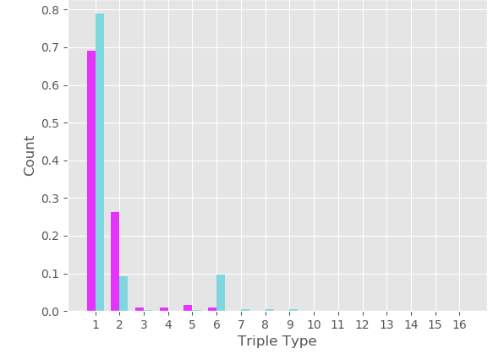
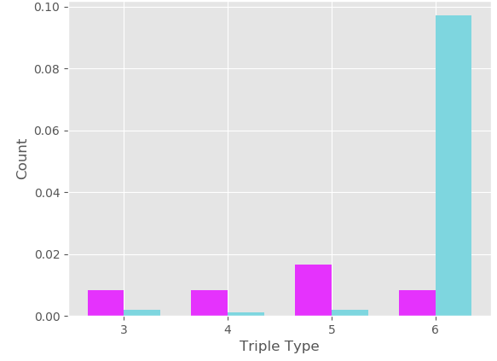
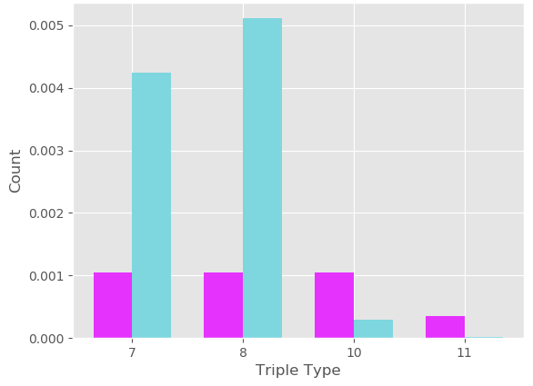
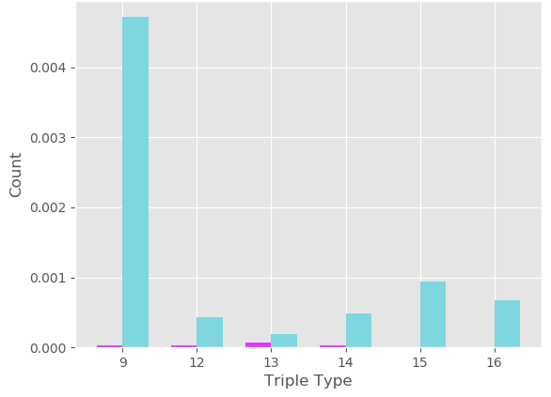
Step 1: Results
Worm
272 neurons
4451 edges
p = 0.0595
purple: calculated
blue : actual

Slide 8
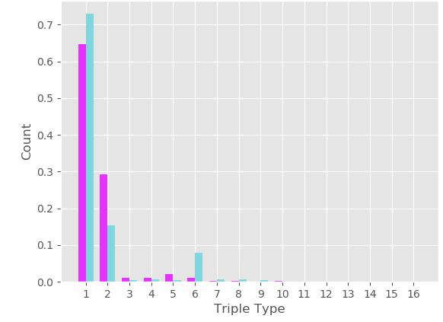
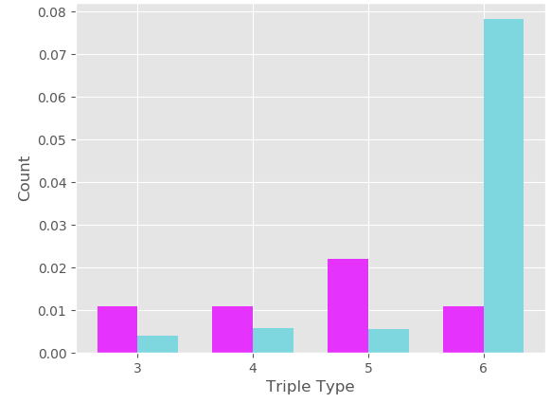
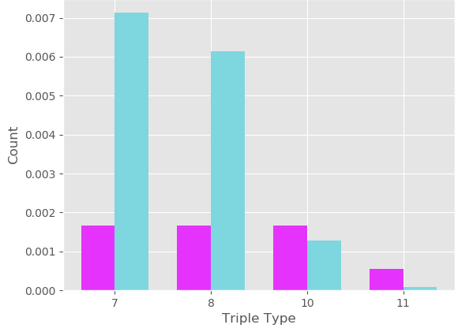
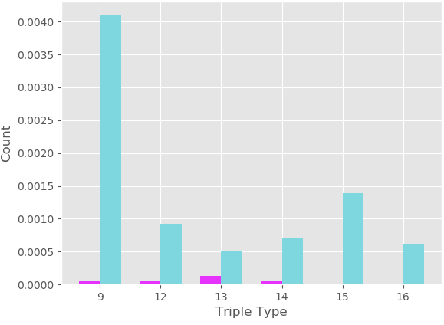
Results
Macque
242 neurons
4090 edges
p = 0.0701
purple: calculated
blue : actual

Slide 9
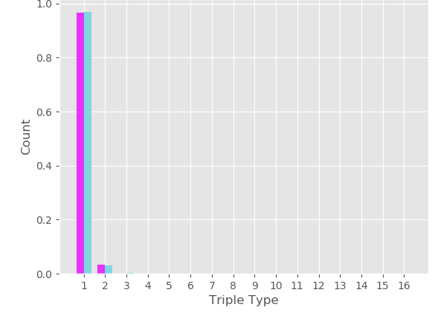
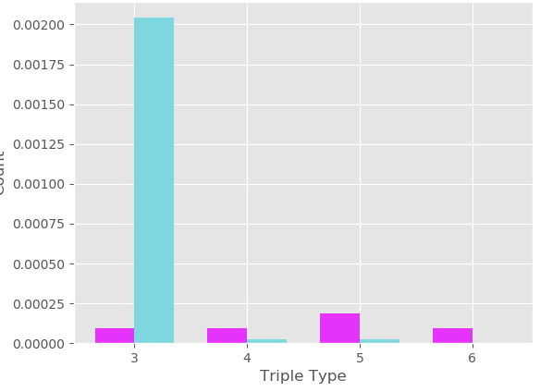
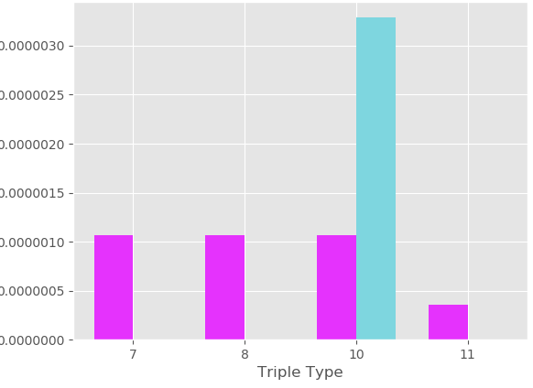
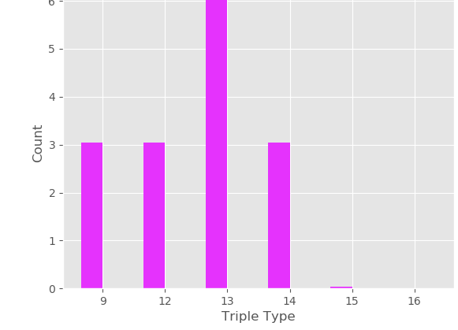
Results
Mouse - visual cortex
195 neurons
214 edges
p = 0.0056
purple: calculated
blue : actual

Slide 10
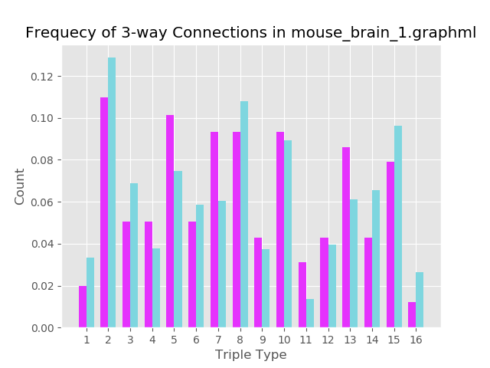
Results
Mouse
213 neurons
21807 edges
p = 0.4795
purple: calculated
blue : actual

Slide 11
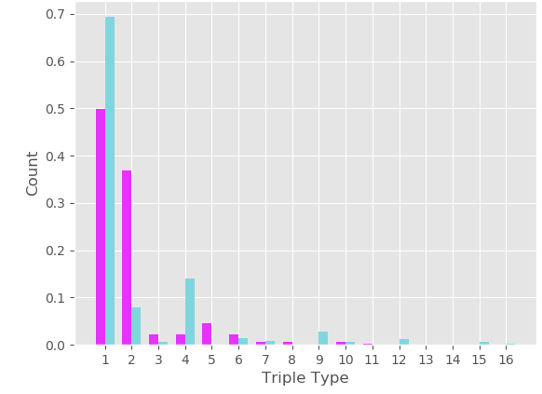
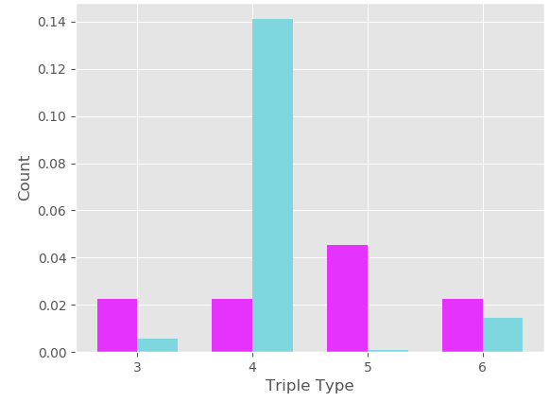
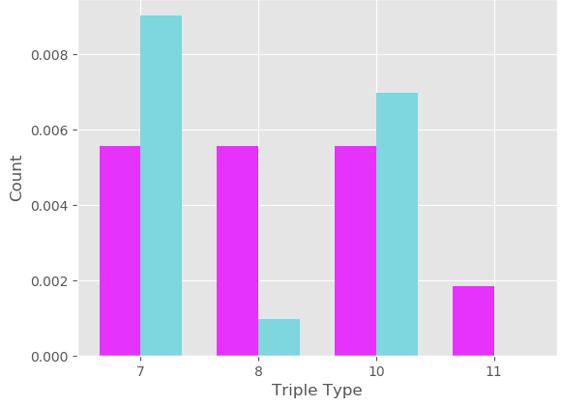
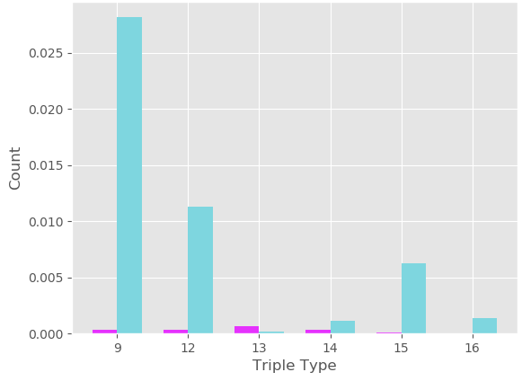
Results
Rat
503 nodes
27667 edges
p = 0.1095
purple: calculated
blue : actual

Slide 12
Step 1: Results
No connection patterns here look uniformly random
Different subjects
Different parts of brain
Different measurement techniques
Small graphs
What is ‘brain-like’ ? Not uniformly random...
Can we measure ‘brain-like’ ? Yes, if given probabilities. Measure connection probabilities for random graph and compare to target ‘brain-like’ probabilities.

Slide 13
Step 2: Randomly Generate Graphs
Can we create ‘brain-like’ ?
Given target probabilities, can we generate such a graph?
Based on step 1, not possible with simple random graph generation algorithms
More complicated model: Stochastic Block Model
Partition nodes into C_1 … C_r, rxr edge prob matrix
For dense graphs (Omega(n^2)), number of partitions is small
Brain is not dense (10^11 nodes, 10^14 edges)

Slide 14
ROC Method
Sparse graph model: Random Overlapping Communities
Approximating Sparse Graphs: The Random Overlapping Communities Model by Samantha Petti and Santosh S. Vempala
ROC model:
Distribution on triples (s, q, b), goal size and connectivity n and d
Randomly select triple, choose community with pr s/n of each node
If b>0, partition into b and s-b nodes for random bipartite graph
Add random graph of density q on community

Slide 15
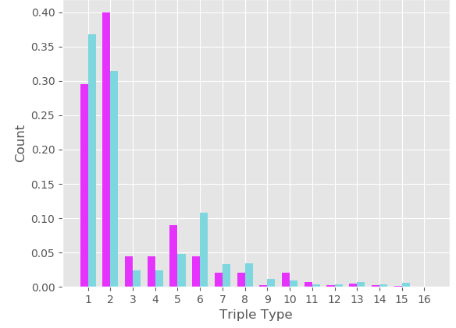
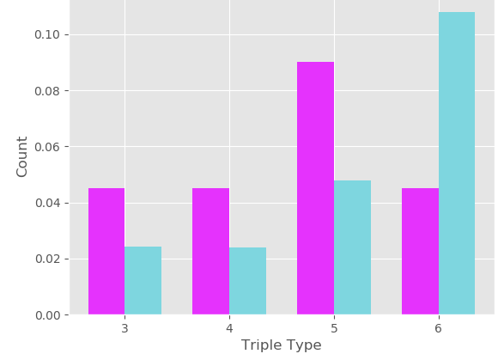
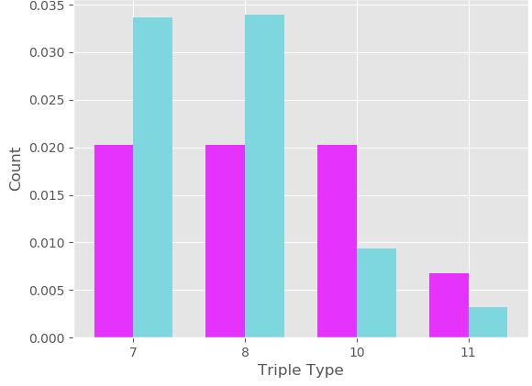
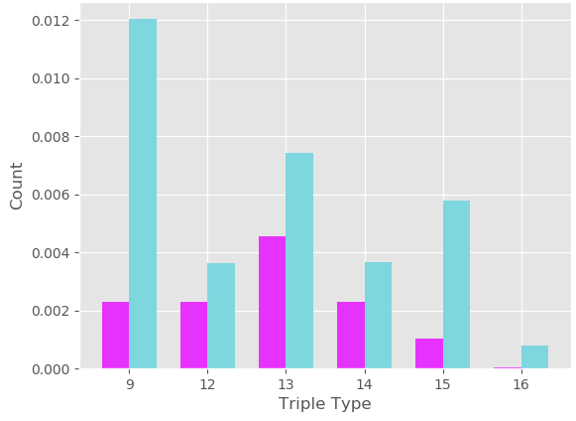
ROC Results
Random ROC graph

Slide 16
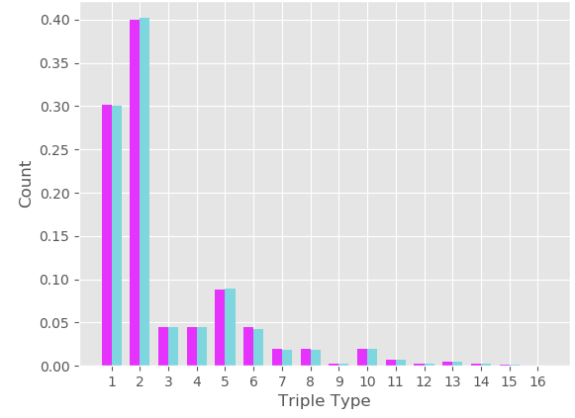
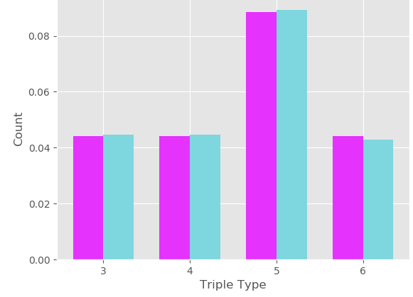
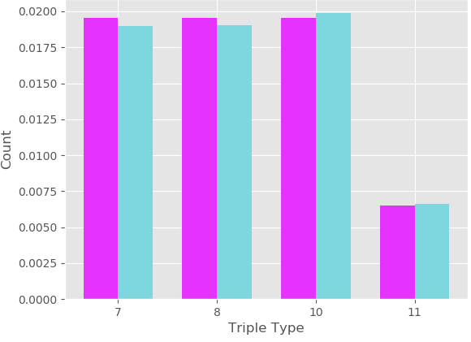
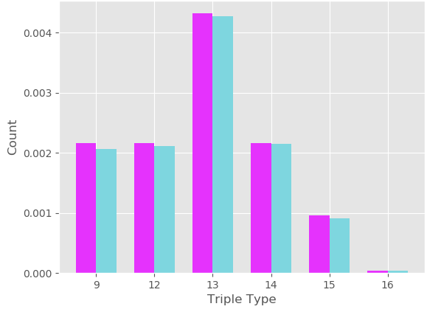
Results
ROC model of Erdos-Renyi
s = n
q = d/n
b = 0

Slide 17
Step 3: Generate Graph to Match Connectome Data
Input: n, d and triple probabilities for connectome graph
Output: distribution of triples for ROC model such that with n and d, running ROC generator will produce graph with desired probabilities
Performance: Reduce error by several orders of magnitude - still not good.
Issues:
Runtime
Number of configurations
Inputs

Slide 18
Conclusions
Breakdown:
What is a ‘brain-like’ graph ?
Something that contains non-uniform connection patterns
Can we measure ‘brain-like’ ?
This part of it, yes.
Can we create ‘brain-like’ ?
Maybe.
Would require more complete connectome data and analysis not currently possible. Could restrict to specific region.
Would require consideration of other important properties of the ‘brain graph’ besides connection patterns.

Slide 19
Questions?

